Slide 1

OPIM 5604 – Predictive Modeling
Automobile Loan Default
Presenter: Venkata vinayaka Durga Prasanth. Lakamsani
Date: December 4, 2022

Slide 2
AGENDA
The Business Problem
Methodology
Sample
Explore
Modify
Model
Assess
Business Value

Slide 3
The Business Problem
It is challenging for a non-banking financial institution (NBFI) to report profits due to the rise in vehicle loan defaults.
The objective is to ascertain the client's loan repayment capacity and comprehend the relative weighting of each factor that affects a borrower's capacity to repay a loan.

Slide 4
OBJECTIVE
Goal: To identify the factors that have the greatest impact on the target variable in order to identify the optimal model for predicting the 'Default' level.
Analyze the data to find the links between the different variables.
Create a variety of prediction models.
Comparison of the models' quality levels
make suggestions for businesses

Slide 5
Dataset Overview
Source: Kaggle
Dataset consists of 121,856 rows and 40 columns.
37 Predictor variables
16 Continuous variables
21 Categorical variables
1 Unique Identifier
1 Target Variable
The target variable is the categorical variable “default”. This column will indicate Yes means the client defaulted on loan payments and No means otherwise.

Slide 6
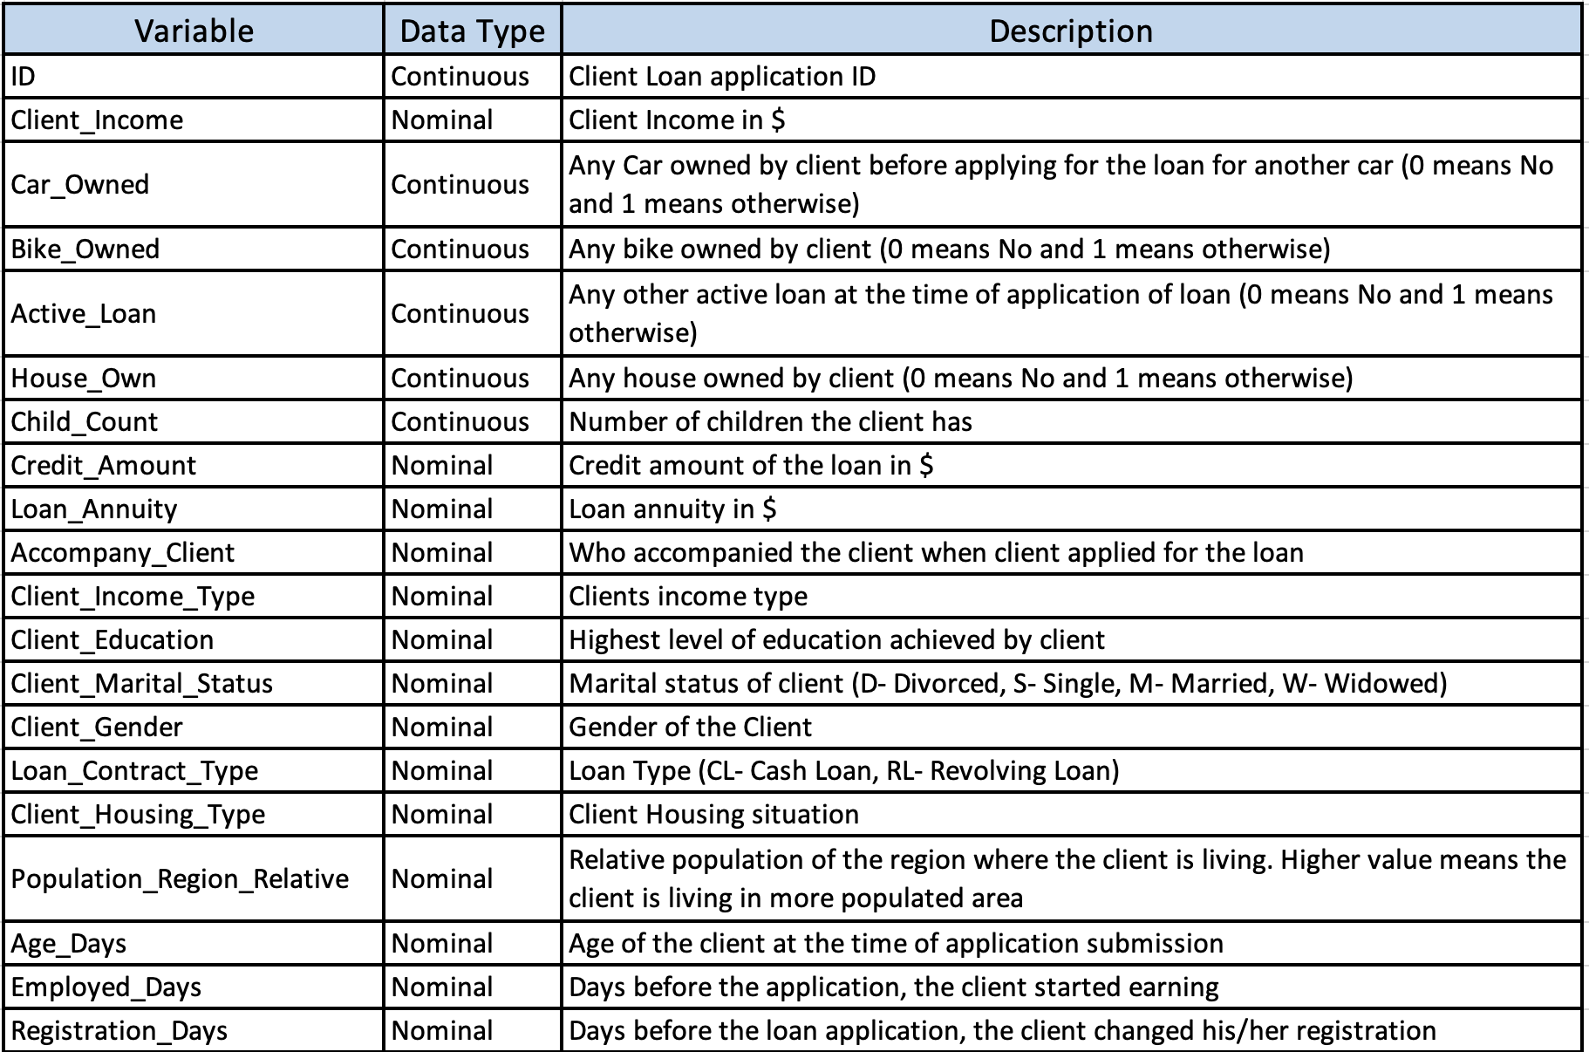
Data Dictionary

Slide 7
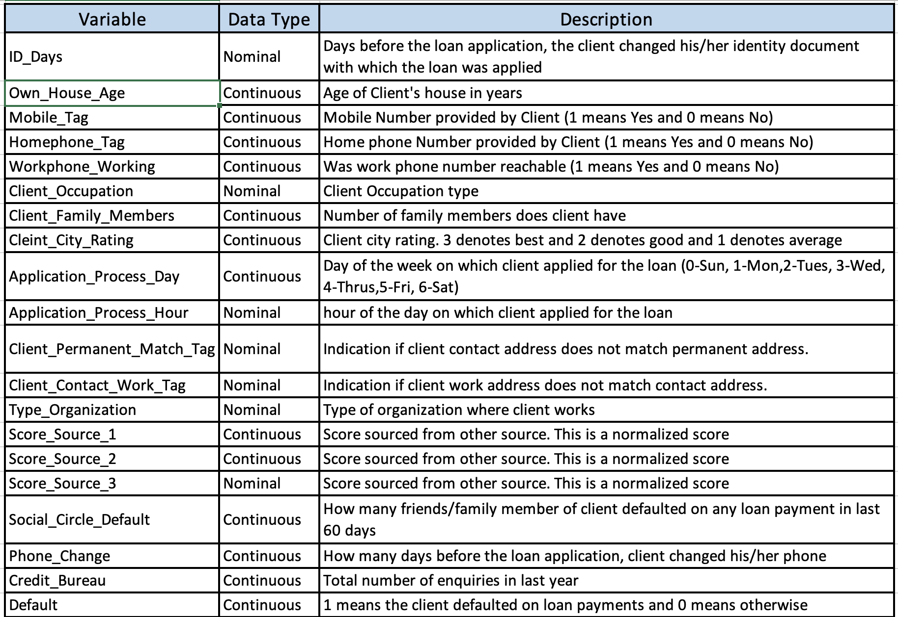
Data Dictionary

Slide 8
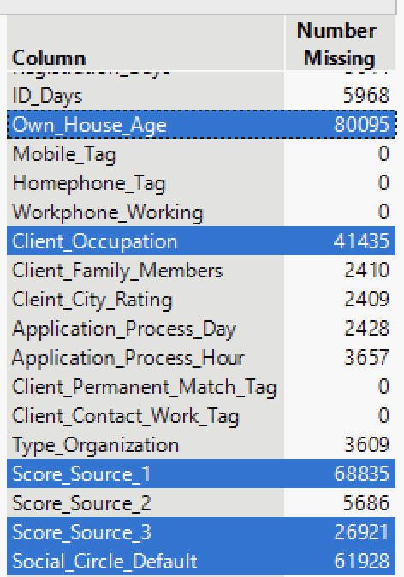
Methodology Explore & Modify
Removing the Columns based on half of the Missing data Own_House_Age, Client_Occupation, Score_Source_1, Score_Source_2, Score_Source_3, and Social_Circle_Default.
Missing Values: Hide and excluded missing values having half of missing data from the rows which are not able to compute.

Slide 9
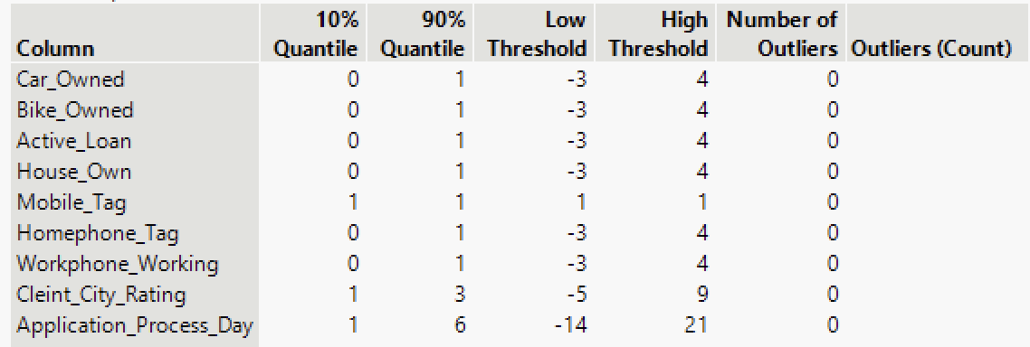
Methodology Explore & Modify
Exploring Outliers: After the elimination of the missing values, there are no outliers in the data set by using the quantile range outliers.
Client_Income, Credit_Amount, and Loan_Annuity are changed to Continuous variables.

Slide 10
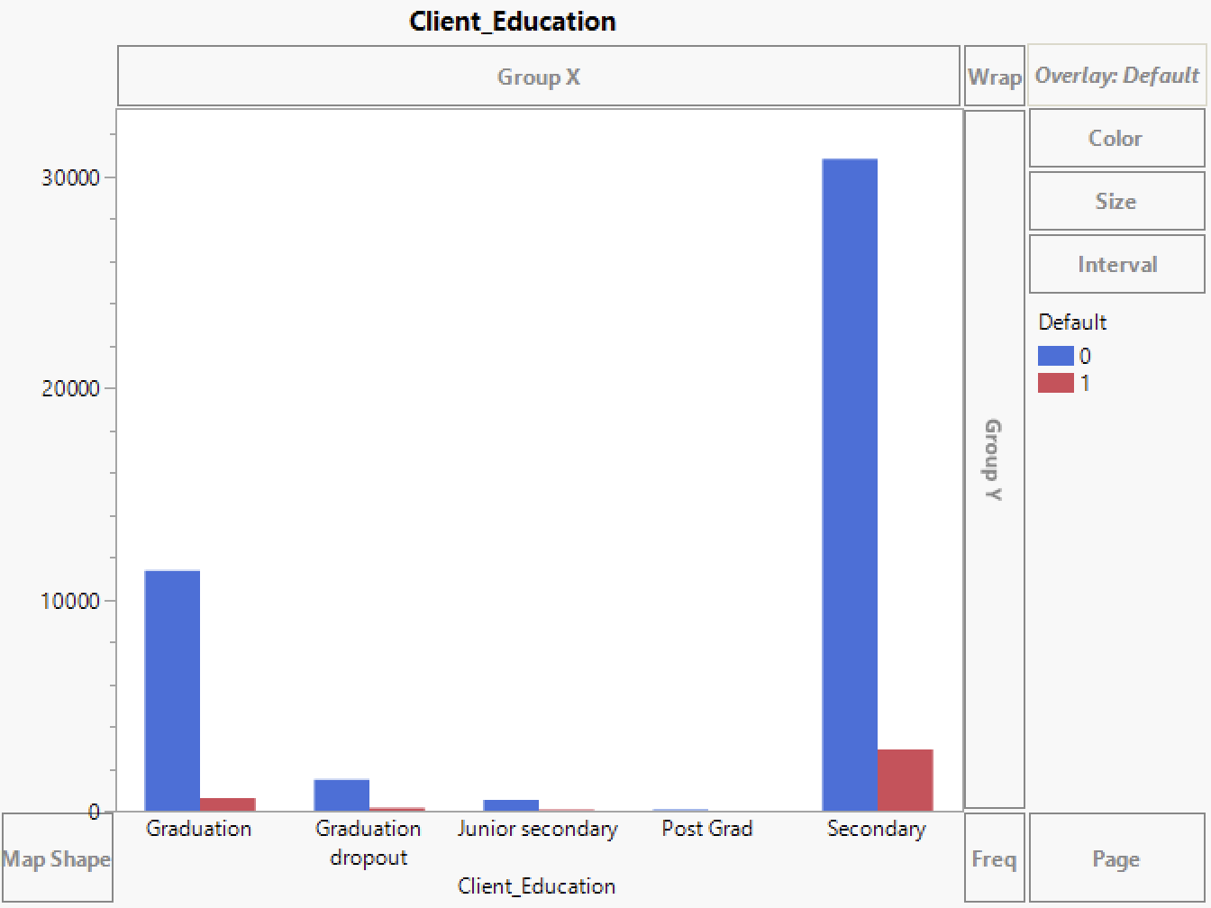
Methodology Explore & Modify
There are high chances of clients defaulting on the automobile loan when the client’s education background is Secondary and Graduation dropout.

Slide 11
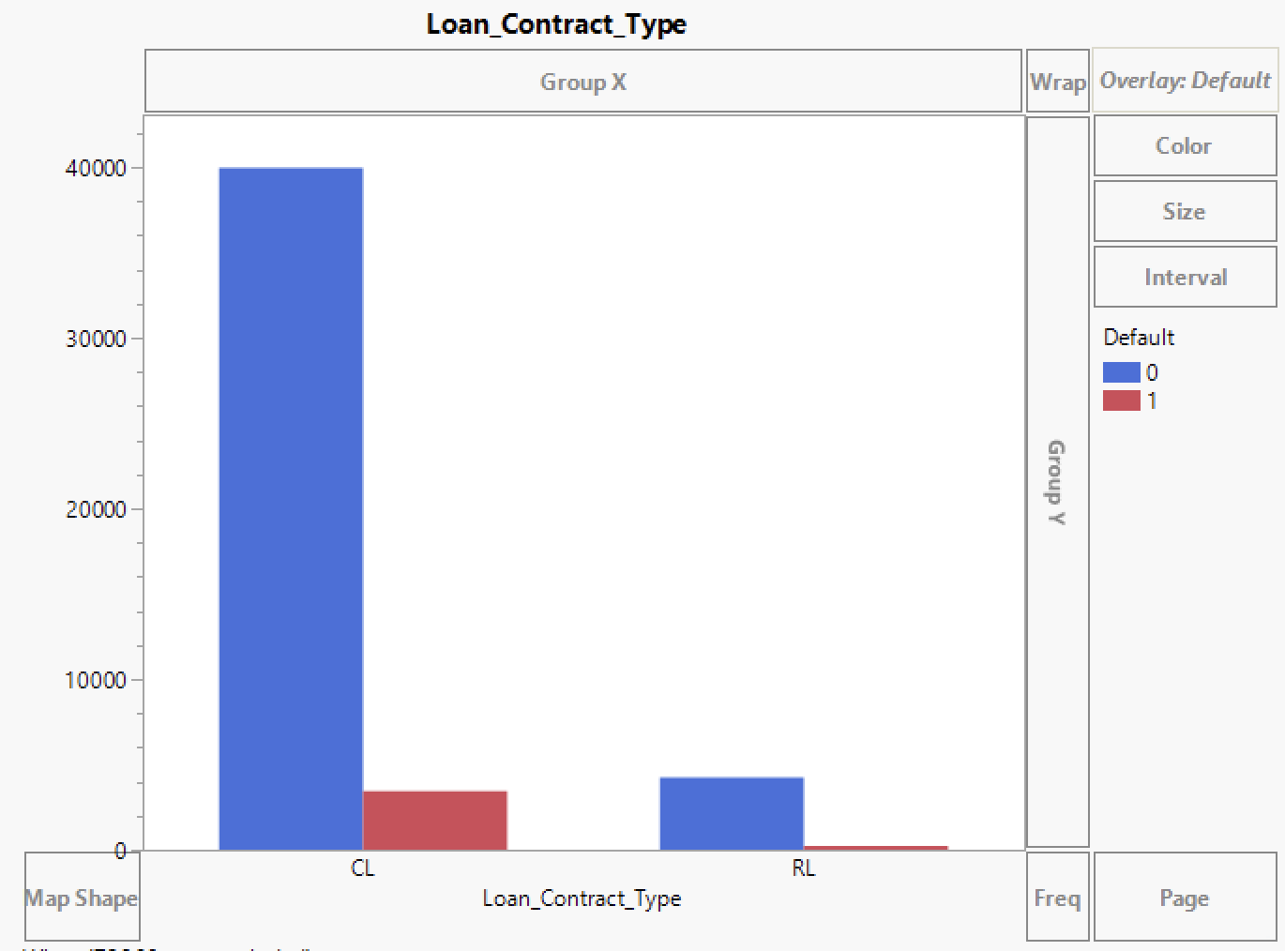
Methodology Explore & Modify
There are high chances of clients defaulting on the automobile loan when the customer is having the Loan_Contract_Type as CL(Cash-Loan).

Slide 12
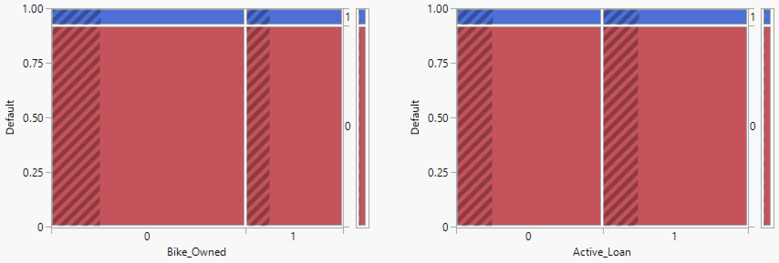
Methodology Explore & Modify
There is no correlation with Bike_Owned and Active_Loan with Default

Slide 13
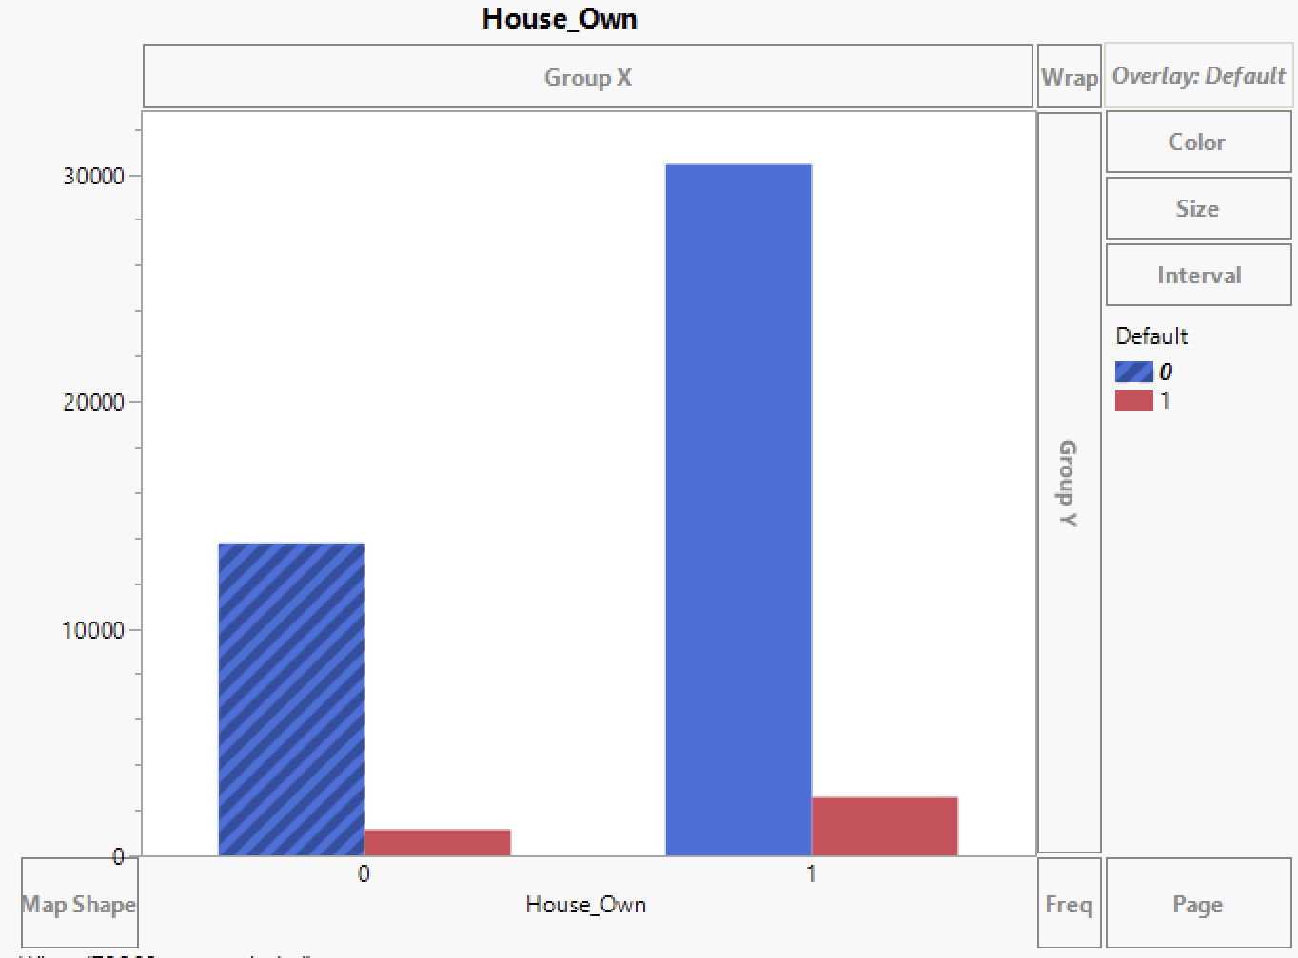
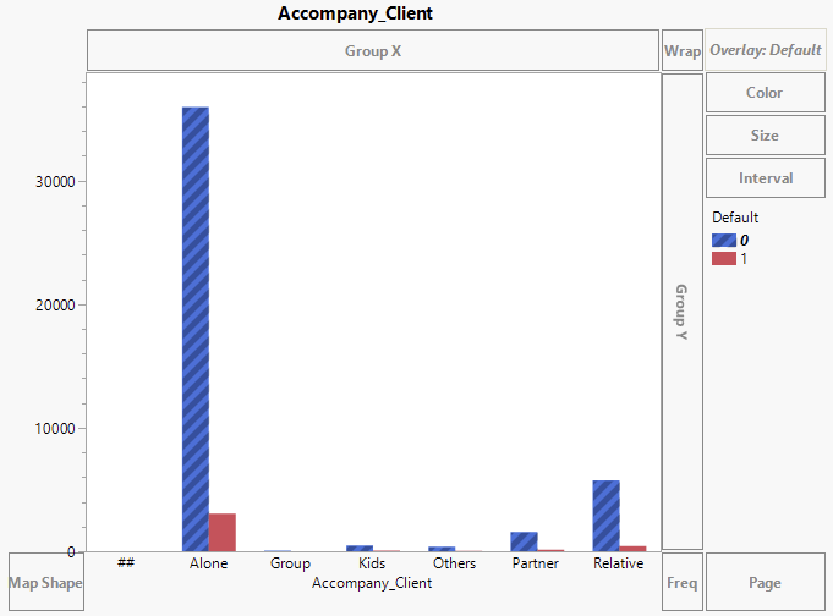
Methodology Explore & Modify
There is No correlation with House_Own and Accompany_Client with Default as both are showing same ratios when compared with Default.

Slide 14
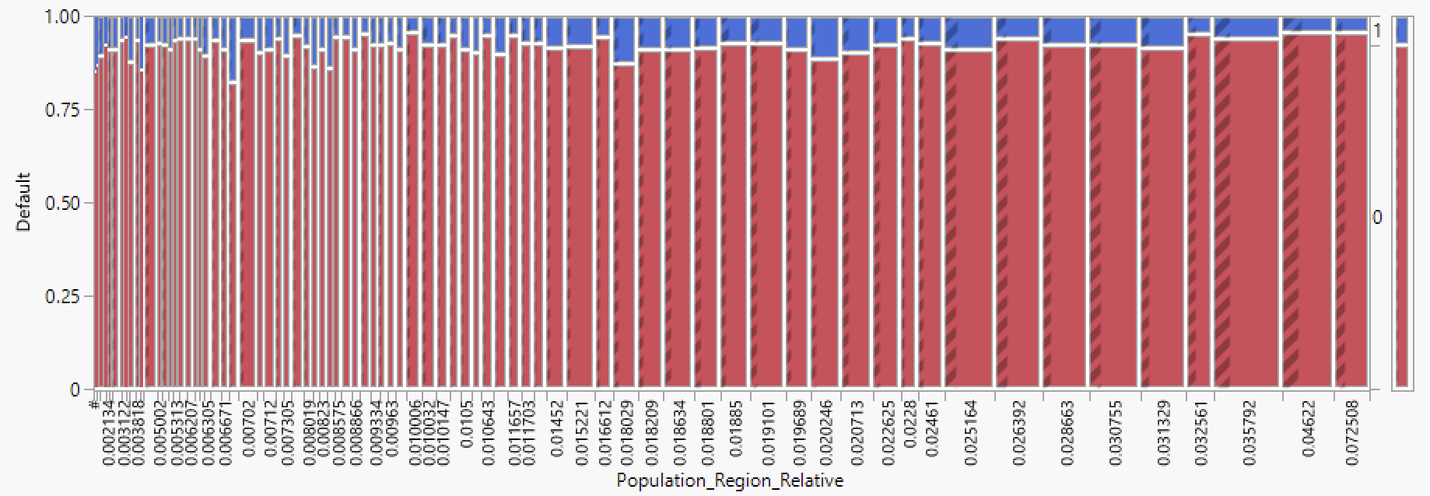
Methodology Explore & Modify
Excluded Population_Region_Relative column, Because it is having 84 unique regions, and hard to interpret to recode.

Slide 15
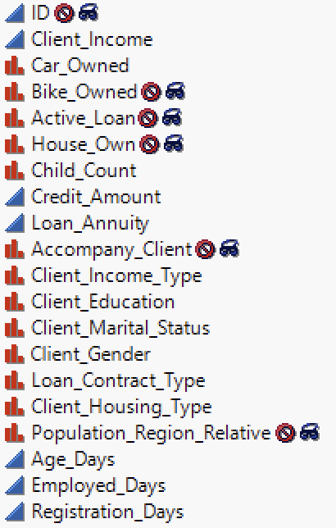
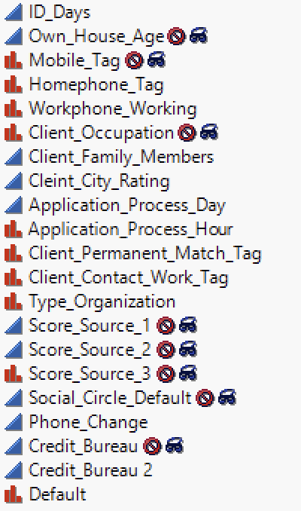
Methodology Modify
ID, Age_Days, Employed_Days, Registration_Days, ID_Days are excluded from the data set as they are having no influence on prediction.
Client_Income, Credit_Amount, and Loan_Annuity are changed to Continuous variables.
Car_Owned, Bike_Owned, Active_Loan, House_Owned, Child_Count, Default, Mobile_Tag, Homephone_Tag and Workphone_Working are changed from Continuous variables to Nominal variables.

Slide 16
Methodology Model
Predicting 1 from the target variable falls within the interest class. However, only 11.7% of the target variable's 1 responses are true.
Initially by using random sampling was employed to divide the data into training, validation, and test groups of 50%, 30%, and 20%, respectively. After the models were created, I observed there is unbalance in the data Due to the low percentage of affirmative responses, So then I have chosen to employ stratified split sampling, to divide the data into training at 50%, validation at 30%, and test at 20%.

Slide 17
Methodology Model
Best Models Evaluation
Model | Data Set | Misclassification rate | RASE | Total Accuracy | Baseline Accuracy | Accuracy of 1 | Lift | AUC from ROC
Logistic Regression | Training | 10.46% | 0.3016 | 89.54% | 11.71% | 83.23% | 7.11 | 0.6476
 | Validation | 10.58% | 0.3039 | 89.42% | 11.71% | 81.11% | 6.93 | 0.6442
 | Test | 10.41% | 0.302 | 89.59% | 11.71% | 83.52% | 7.13 | 0.6429
Boostrap Forest | Training | 10.47% | 0.3031 | 89.53% | 11.71% | 82.13% | 7.01 | 0.6821
 | Validation | 10.60% | 0.3053 | 89.40% | 11.71% | 79.23% | 6.77 | 0.6552
 | Test | 10.45% | 0.3033 | 89.55% | 11.71% | 80.37% | 6.86 | 0.6478
Decision Tree | Training | 10.46% | 0.302 | 89.54% | 11.71% | 82.94% | 7.08 | 0.6236
 | Validation | 10.60% | 0.3053 | 89.40% | 11.71% | 80.67% | 6.89 | 0.6071
 | Test | 10.44% | 0.3037 | 89.56% | 11.71% | 82.73% | 7.06 | 0.5943

Slide 18
Methodology Model
Best Models selected
Logistic Regression
Has high Accuracy of 1’s.
Among all models, the test data model had the lowest misclassification rate (10.41%).
Bootstrap Forest
Being one of the three models with the highest misclassification rate.
Decision Tree
The decision tree has a slight overfitting.

Slide 19
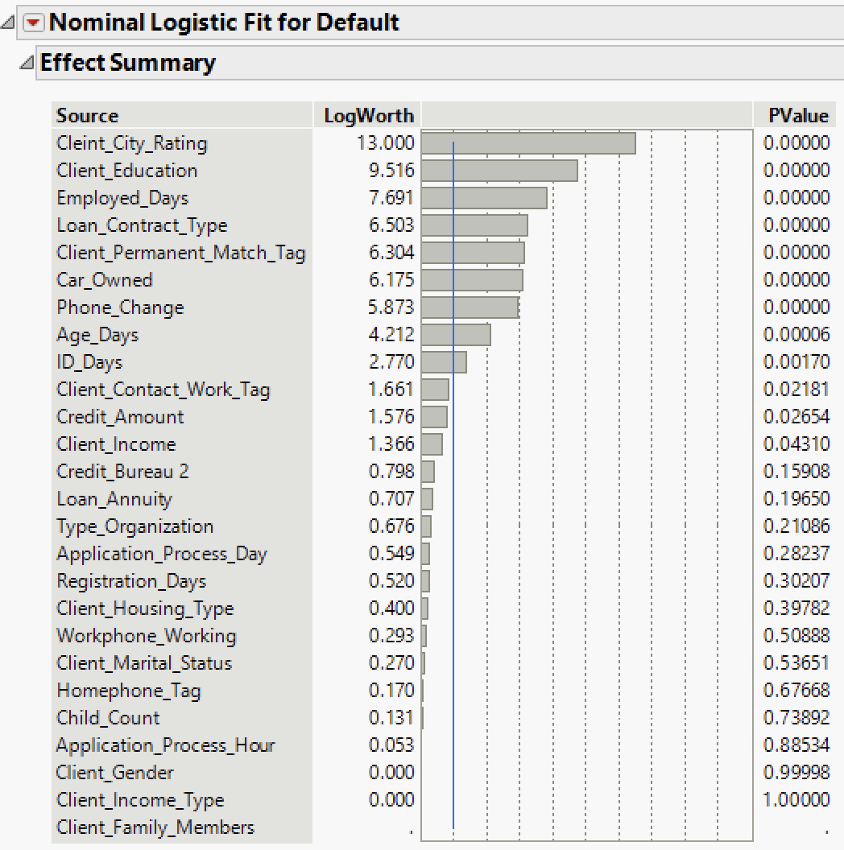
Logistic Regression Model
For training, validation, and test, respectively, the first misclassification rates were 10.78%, 10.91%, and 10.82%.
After model tuning the misclassification rates are as follows for training-10.46%, validation-10.58%, and test 10.41%.

Slide 20
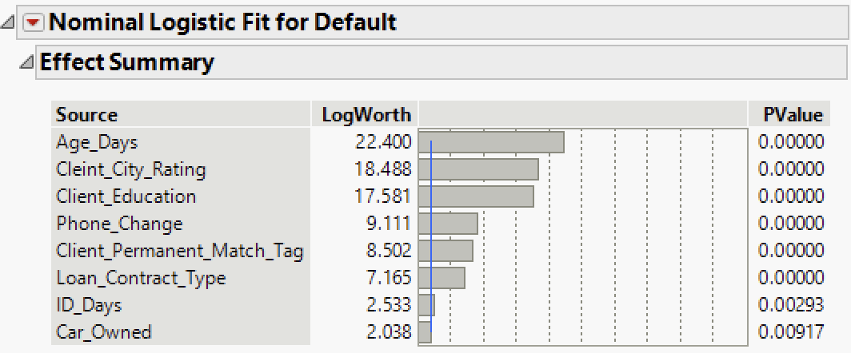
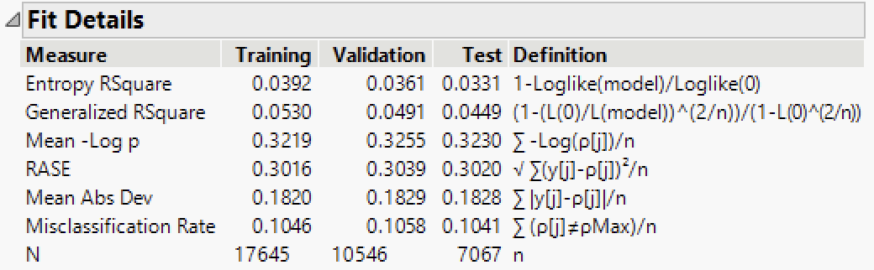
Logistic Regression Model
In order to achieve a better-performing model with less complexity, high Pvalue variables are removed from the model through model tuning by analyzing the misclassification rate.
Model | Data Set | Misclassification rate | RASE | Total Accuracy | Accuracy of 1 | Lift
Logistic Regression | Training | 10.46% | 0.3016 | 89.54% | 83.23% | 0.93
 | Validation | 10.58% | 0.3039 | 89.42% | 81.11% | 0.91
 | Test | 10.41% | 0.302 | 89.59% | 83.52% | 0.93

Slide 21
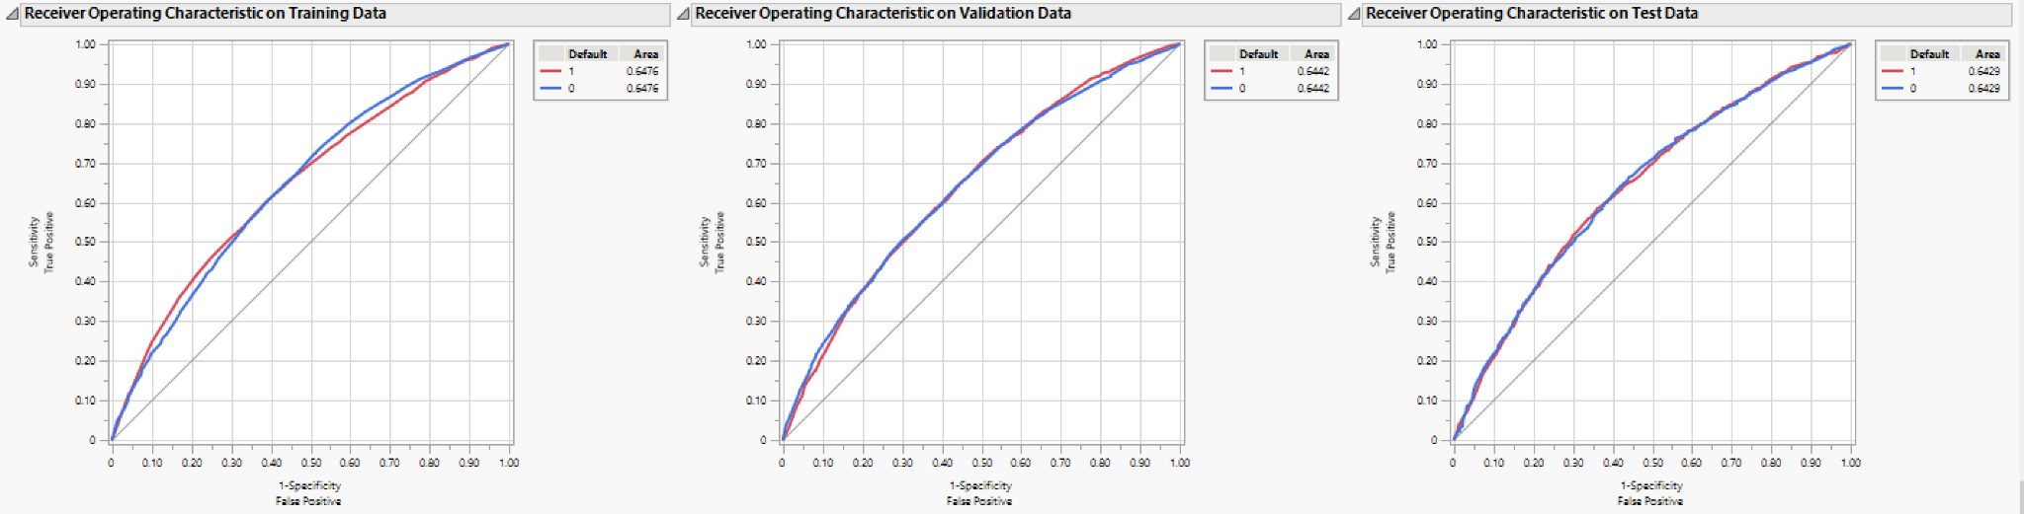
Logistic Regression Model
ROC curve for the final tuned model

Slide 22
Business Value
Based on the model's information, I observed a high chance of the client defaulting on an automobile loan when the client’s educational background is Secondary and Graduation dropout.
And Clients having the Loan_Contract_Type as CL(Cash-Loan) are also having a high chance of defaulting.
The NBFI has to increase the interest rates for clients who are having an educational background in Secondary and Graduation dropouts.
If a client is having 1’s or yes in this 1.Phone_Change, 2.Car_Owned, 3.Client_Permanent_Match_Tag, 4.Loan_Contract_Type, 5.Employed_Days, and 6.Client Education. The risk of getting defaulted by the client is in increasing order from 1 to 6.

Slide 23
THANK YOU

Slide 24
Appendix
Bootstrap Forest
Decision Tree

Slide 25
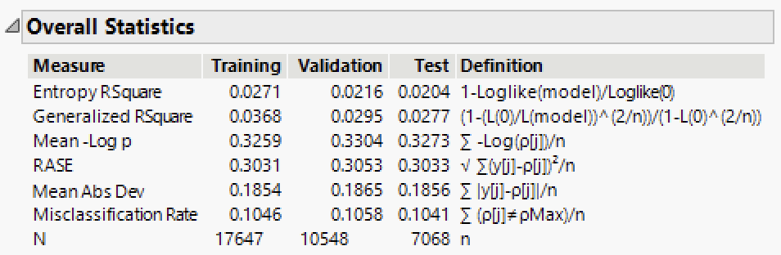
Bootstrap Forest

Slide 26
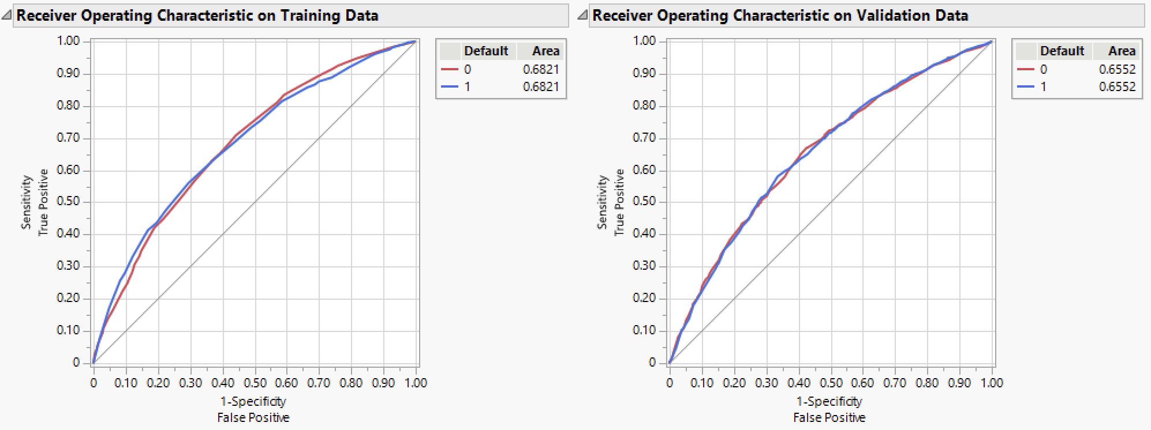
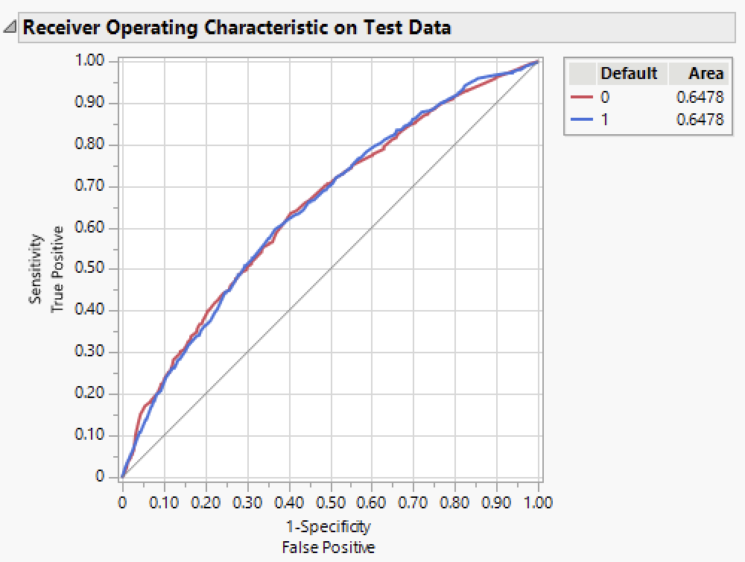
Bootstrap Forest

Slide 27
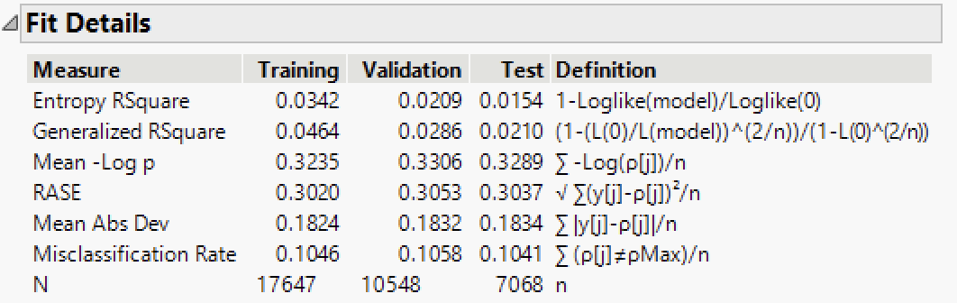
Decision Tree

Slide 28
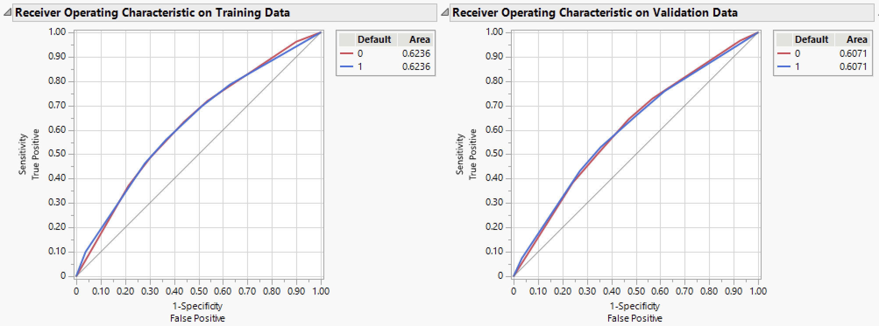
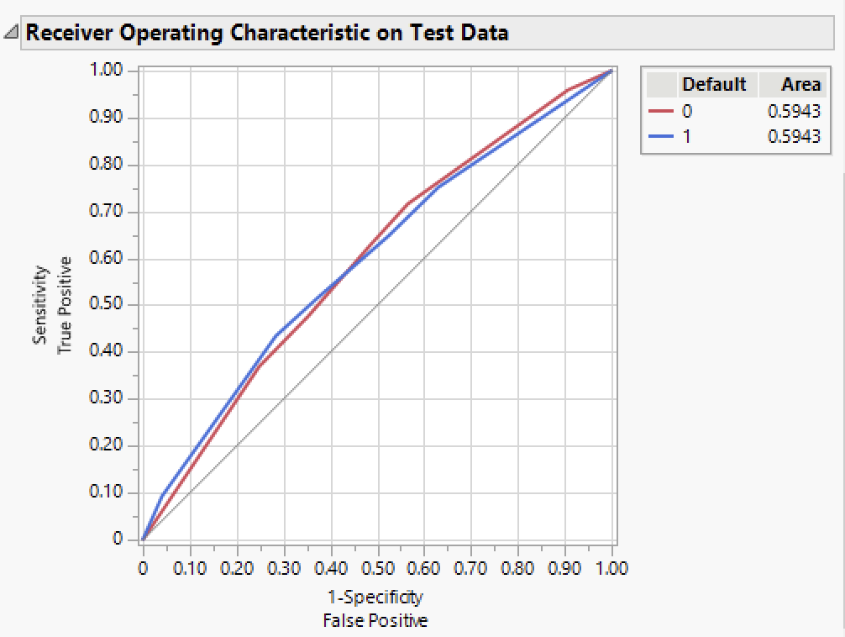
Decision Tree

Slide 29
References
OPIM 5604 Video lectures
Shmueli, G. (2017). Data mining for business analytics: Concepts, techniques, and applications with JMP Pro. Hoboken, NJ: Wiley.
Dataset link: https://www.kaggle.com/datasets/saurabhbagchi/dish-network-hackathon?select=Train_Dataset.csv
Tool used : JMP 16

